Slide 1

HAND GESTURE 3D POSE ESTIMATION AND RECOGNITION BASED ON EVENT CAMERA RECORDS
FINAL PRESENTATION ROBOTICS PERCEPTION
Presented by: Shamma Alblooshi 100045387

Slide 2

PROBLEM STATEMENT AND OBJECTIVES

Slide 3
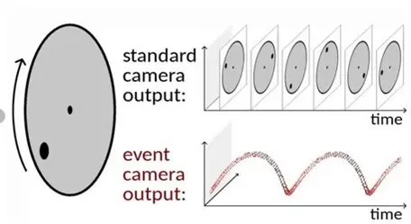
INTRODUCTION
Event-based vision mimics the human eye by capturing changes in the scene, offering advantages such as:
High temporal resolution: Records data at microsecond intervals.
Low latency: Enables real-time processing.
Power efficiency: Only processes changes, reducing computational overhead.
Applications of event-based vision include robotics, augmented reality (AR), virtual reality (VR), and human-computer interaction.
3D Hand Gesture Posture and Recognition
3D hand gesture posture estimation involves determining the precise 3D positions of hand joints, enabling applications like:
Gesture-based interaction in virtual reality (VR) and augmented reality (AR).
Real-time control in robotics and gaming.
Sign language interpretation for improved accessibility.

Slide 4


Challenges with existing systems:
Motion Blur and Latency:
Traditional vision systems struggle with motion blur during fast hand movements.
Latency in processing full video frames impacts real-time applications.
Computational Cost:
Dense image data requires significant computational resources, which is unsuitable for low-power devices.
Event cameras overcome these issues, providing high-resolution temporal data, which is crucial for accurate and real-time 3D hand posture recognition.
Proposed Solution:
Utilize the Ev2Hands framework, which combines:
Event-based data streams: Captures only changes in the scene.
Pre-trained 3D hand pose models: Efficiently estimate joint positions.
Hierarchical feature extraction: Learns local and global features for robust predictions.

Slide 5
METHODOLOGY

Slide 6
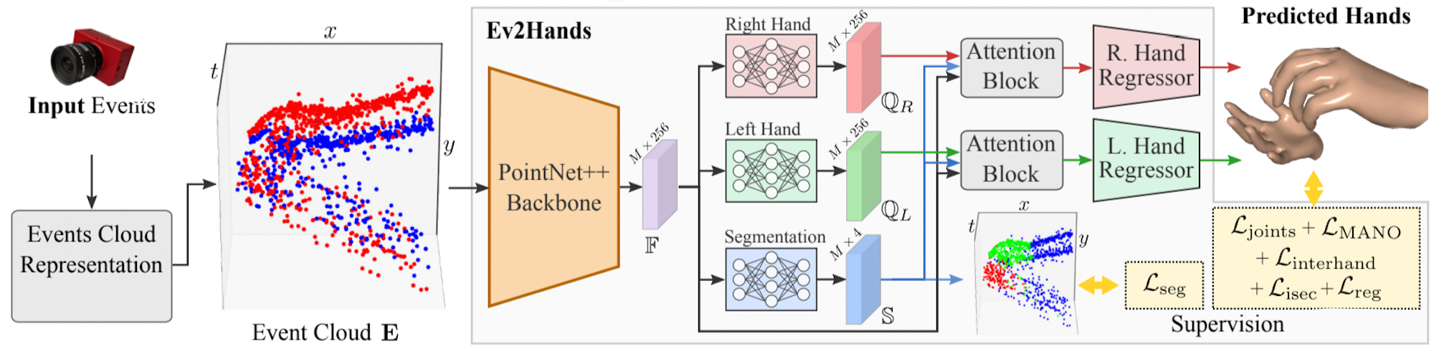
FULL FRAMEWORK

Slide 7
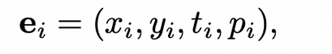
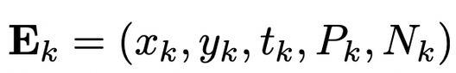
CONVERTING EVENT DATA TO EVENT CLOUD REPRESENTATION
Input:
Raw event stream data from the event camera (contains spatiotemporal information: [x, y, t, p], where p is polarity).
High temporal resolution data for capturing dynamic hand movements.
Process:
Convert the event data into a structured event cloud representation, which is a set of points in a 3D space:
x, y: pixel coordinates
t: average time of the combined events
P, N: number of positive and negative events in the time interval considered
Output:
A normalized event cloud that represents the spatiotemporal and polarity information of the input events.
Enables efficient processing using deep learning frameworks like PointNet++.

Slide 8
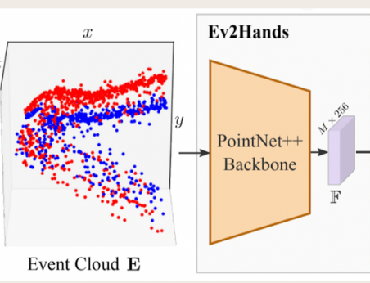
PROCESSING EVENT CLOUD WITH POINTNET++
Input:
The normalized event cloud from the previous step.
Process:
PointNet++ architecture processes the event cloud hierarchically:
Sampling: Uses Farthest Point Sampling (FPS) to reduce the number of points while maintaining a uniform distribution.
Grouping: Applies ball query to group nearby points into local regions.
Feature Learning: Uses MLPs and max pooling to extract local and global features from the grouped points.
Output:
Event Feature Representation:
A feature vector capturing the spatial and temporal relationships in the event cloud.
Encodes hand gesture dynamics for further processing.

Slide 9
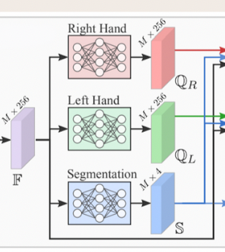
BRANCHING THE EVENT FEATURE REPRESENTATION
Input:
Event features extracted from PointNet++.
Process:
The event feature vector is passed through three parallel branches:
Left Hand Branch:
Predicts features specific to the left hand.
Outputs: QL (feature vector for the left hand).
Right Hand Branch:
Predicts features specific to the right hand.
Outputs: QR (feature vector for the right hand).
Segmentation Branch:
Processes the event features to predict class logits for each point in the event cloud.
Outputs: S , which is a segmentation map
Outputs:
Three feature vectors: QL, QR, and S, representing left hand, right hand, and segmenattion, respectively.

Slide 10
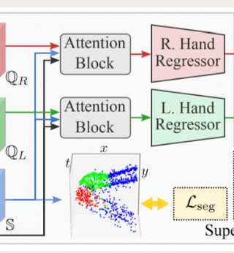
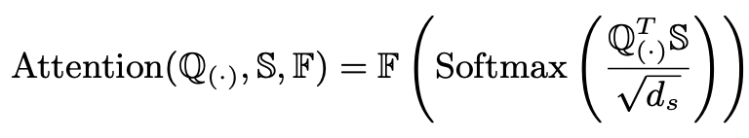
ENHANCING FEATURES WITH ATTENTION
Input:
Feature vectors: QL (left hand), QR (right hand), S
Process:
Attention Block:
Enhances the left (QL) and right (QR) hand features using attention mechanisms.
Computes the relationship between QL, QR, and S to focus on important spatial-temporal patterns.
The attention block adjusts the feature vectors to highlight critical regions and suppress irrelevant information.
Output:
Enhanced feature vectors for the left and right hands: QL' and QR'.

Slide 11
REGRESSING HAND POSES
Input:
Enhanced feature vectors QL' and QR'.
Process:
Regressor:
A fully connected neural network that maps the enhanced features to 3D hand poses (joint positions).
Loss Function:
Combines multiple loss components to train the model effectively:
Regression Loss: Minimizes the error between predicted and ground truth joint positions.
Temporal Consistency Loss: Ensures smooth transitions between consecutive frames.
Output:
Predicted 3D joint positions for the left and right hands.

Slide 12
GENERATING 3D HAND POSE PREDICTIONS
Input:
Output of the regressor: Predicted 3D joint positions.
Process:
The predicted joint positions are scaled and transformed to match the physical hand pose.
Output:
Final 3D hand pose predictions:
Visualized as a set of 3D joint locations.
Enables applications like gesture recognition and virtual interaction.

Slide 13
EXPERIMENTAL SETUP & DATASET COLLECTION

Slide 14
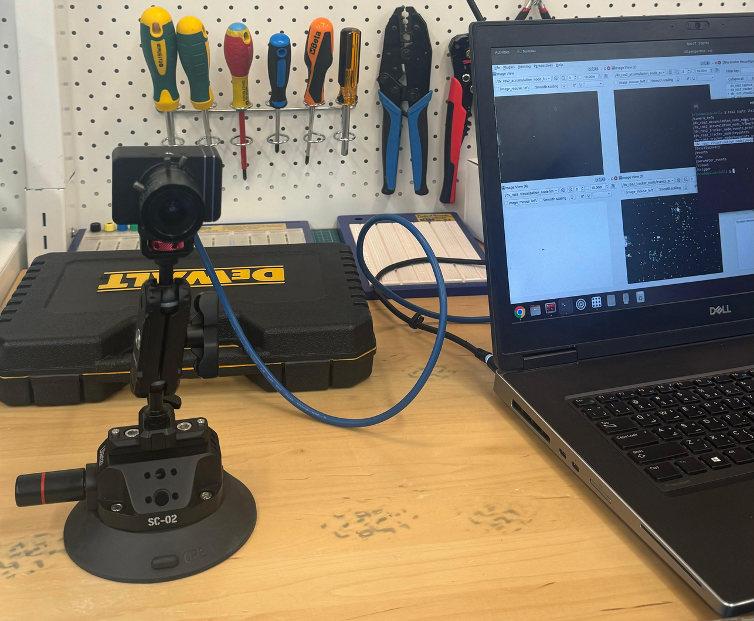
SETUP
The experimental setup consists of an event camera mounted securely on a tripod with a suction base for stability.
The camera is connected to a laptop via a USB interface, facilitating data capture and processing in real-time.
The output was given by the lab engineer Murad as ros bags
Ros bags were used to be converted to mp4 videos

Slide 15
RESULTS

Slide 16
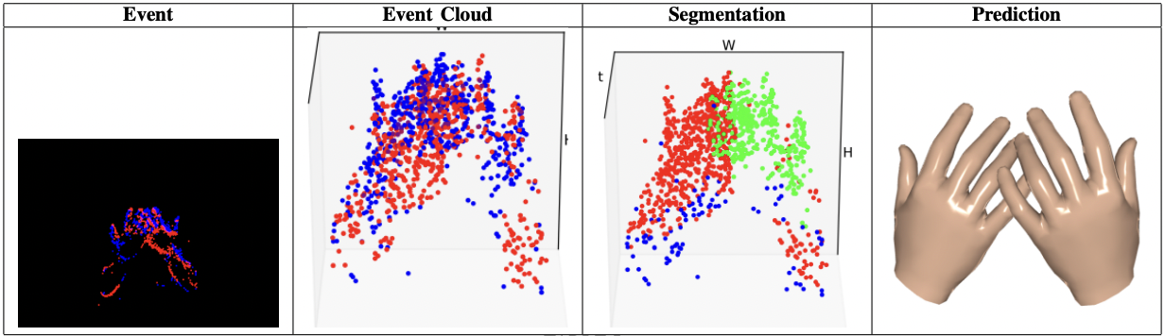
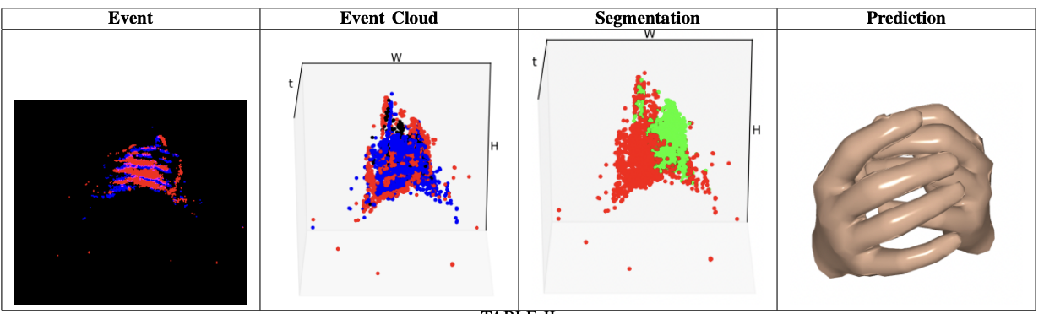
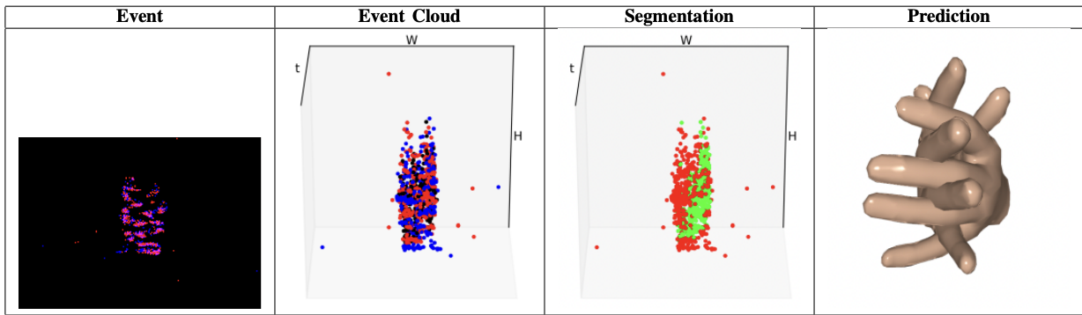
DIFFERENT HAND GESTURE EVENTS

Slide 17
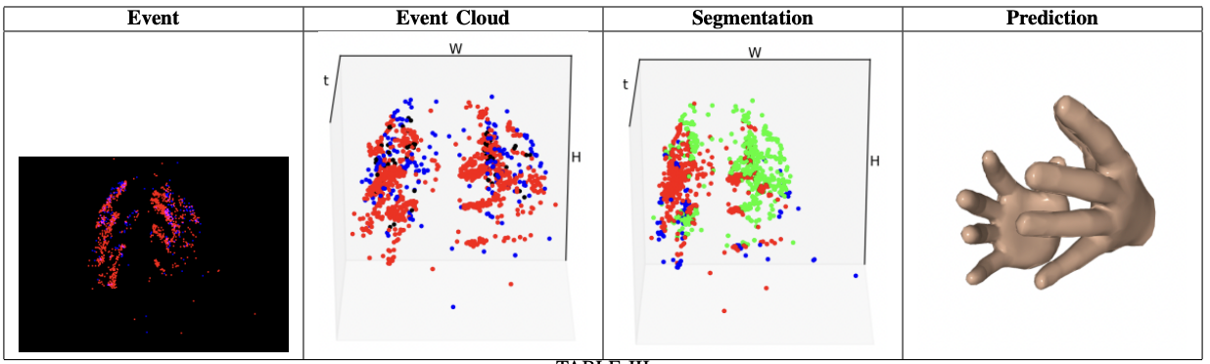
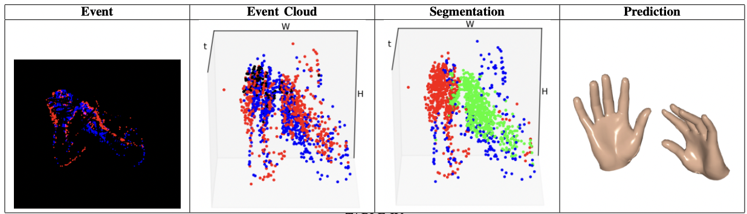
DIFFERENT HAND GESTURE EVENTS

Slide 18
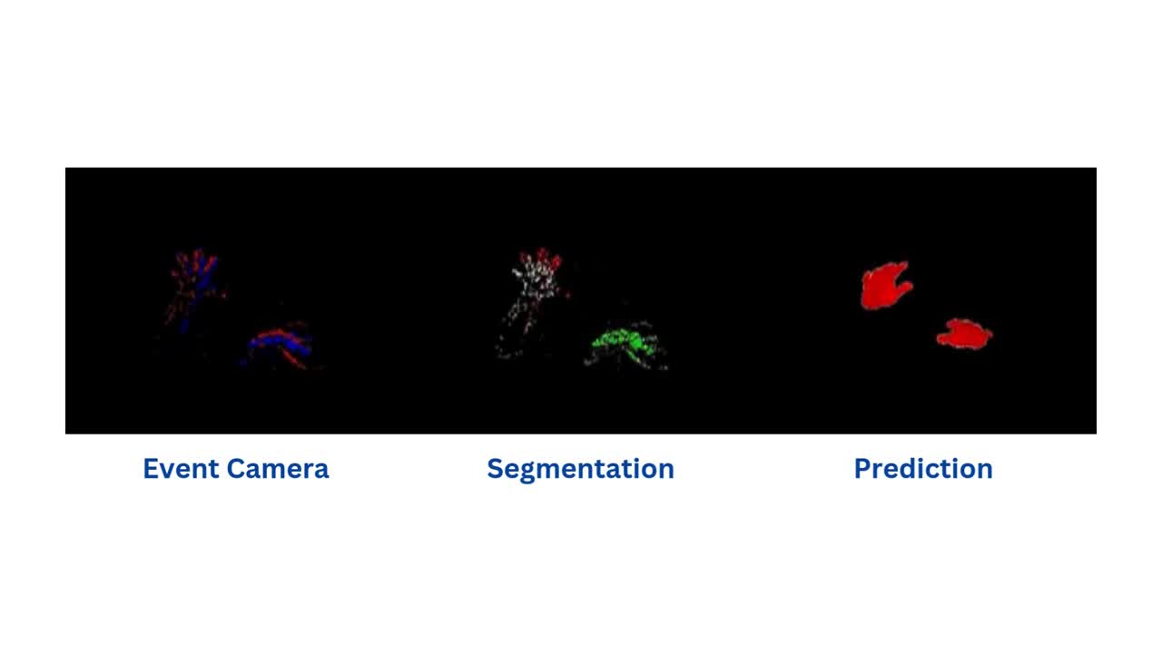
DEMO VIDEO 1

Slide 19
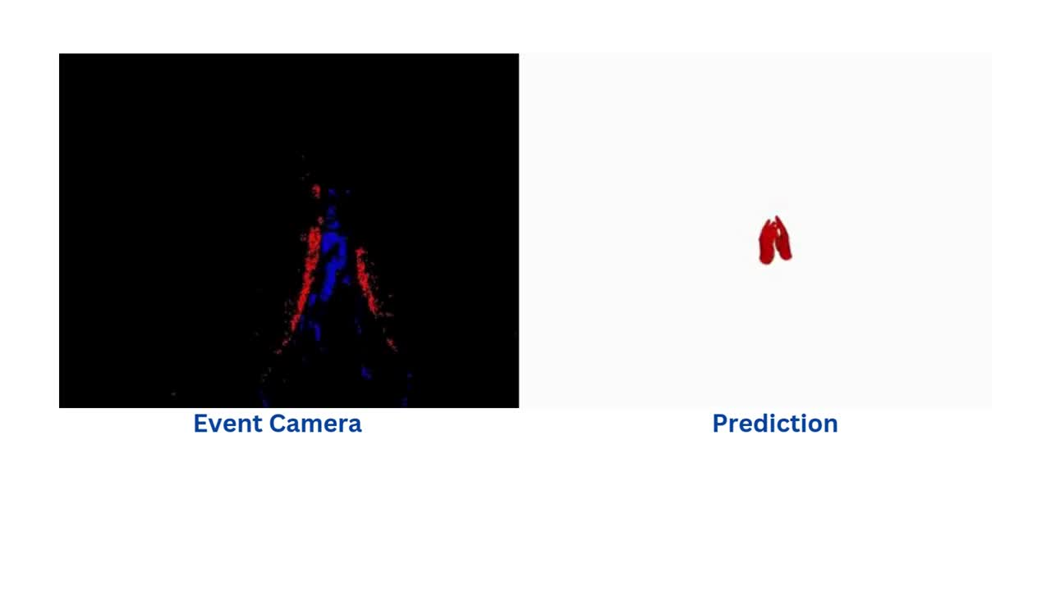
DEMO VIDEO 2

Slide 20
STRENGTHS

Slide 21
STRENGTHS
Utilizes event cameras capable of capturing changes at microsecond intervals, making it highly effective for fast and dynamic hand gestures.
High Temporal Resolution
Event cameras inherently avoid motion blur by capturing only changes, ensuring accurate hand pose estimation even during rapid hand movements.
Robustness to Motion Blur
The framework is optimized for low-latency applications, making it suitable for real-time hand gesture recognition
Real-Time Performance
Handles complex hand motions and interactions effectively, showcasing adaptability to real-world scenarios.
Handles complex scenarios

Slide 22
LIMITATIONS AND FUTURE WORK

Slide 23
LIMITATIONS AND FUTURE WORK
The current approach assumes a stationary camera, which simplifies the problem but limits usability in dynamic or mobile setups.
Fixed Camera Assmption
Event data generated by moving objects or changes in the background can introduce noise, reducing segmentation accuracy.
Background Clutter
Future work
Moving Camera Integration:
Extend the framework to handle data from moving or portable event cameras, addressing challenges of background clutter and motion compensation.
RGB and Event Data Fusion:
Combine event data with traditional RGB streams to leverage the strengths of both modalities:
Increased visual fidelity from RGB.
Low latency from event data.

Slide 24

THANK YOU !

Slide 25
REFERENCES

Slide 26
[1] Riccardo Mangiaracina, Alessandro Perego, Arianna Seghezzi, and
Angela Tumino. Innovative solutions to increase last-mile delivery
efficiency in b2c e-commerce: a literature review. International Journal
of Physical Distribution & Logistics Management, 49(9):901–920, 2019
[2] Ming Li, Jian Weng, Anjia Yang, Wei Lu, Yue Zhang, Lin Hou, Jia-
Nan Liu, Yang Xiang, and Robert H. Deng. Crowdbc: A blockchain-
based decentralized framework for crowdsourcing. IEEE Transactions
on Parallel and Distributed Systems, 30(6):1251–1266, 2019.
[3] Maha Kadadha, Hadi Otrok, Rabeb Mizouni, Shakti Singh, and Anis
Ouali. Sensechain: A blockchain-based crowdsensing framework for
multiple requesters and multiple workers. Future Generation Computer
Systems, 105:650–664, 2020.
[4] Seth Larweh Kodjiku, Tao Han, Yili Fang, Esther Stacy E.B Aggrey,
Collins Sey, Kwame O. Asamoah, Linda Delali Fiasam, Evans Aidoo,
and Xun Wang. Wqcrowd: Secure blockchain-based crowdsourcing
framework with multi-tier worker quality evaluation. Journal of King
Saud University - Computer and Information Sciences, 35(10):101843,
2023.
[5] Zhifang Liao, Jincheng Ai, Shaoqiang Liu, Yan Zhang, and Shengzong
Liu. Blockchain-based mobile crowdsourcing model with task security
and task assignment. Expert Systems with Applications, 211:118526,
2023.
[6] Qiliang Yang, Tao Wang, Wenbo Zhang, Bo Yang, Yong Yu, Haiyu Li,
Jingyi Wang, and Zirui Qiao. Privcrowd: A secure blockchain-based
crowdsourcing framework with fine-grained worker selection. Wireless
Communications and Mobile Computing, 2021(1):3758782, 2021

